Slide 1
Social Sentiment Analysis on Twitter Data
- By Krishika Jain, Nayana Mahajan and Dhruv Shah

Slide 2

CONTENTS
CONTENTS
Project Scope
Data Source – Twitter API
Methodology
Data Streaming using Kafka on Apache Spark
Data Cleaning and Processing using Python
Sentiment Analysis using Google Cloud Natural Language
Visualization of Tweets using Tableau

Slide 3
PROJECT SCOPE
Due to rise of COVID-19 cases, and stricter lock downs and work from home, people have been expressing different sentiments in social media such as Twitter. Social media has played a significant role during COVID-19 which has driven researchers for analysis with NLP and machine learning methods.
Social media posts and tweets brings another level of understanding when combined with sentiment analysis.
Our Aim is to perform social sentiment analysis on twitter data for Covid-19 vaccinations and to evaluate the polarity of the tweets as positive, negative or neutral.

Slide 4
DATA SOURCE
Data is Extracted from Twitter API.(Require a Twitter Developer Account with API Key and Consumer key)
Tweets are the converted to a Data frame in Google Colab with Pandas
Used Vader from NLTK for Sentiment Analysis
Data Cleaning process is performed in python

Slide 5



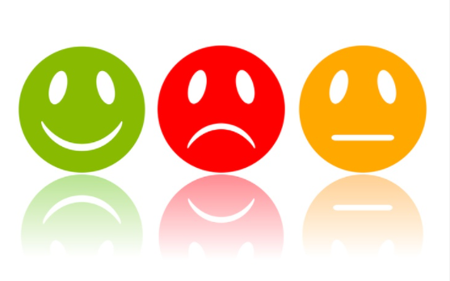

DATA CLEANING AND PROCESSING USING PYTHON
API
EDA
Sentiment Analysis
Sentiments

Slide 6


DATA STREAMING USING KAFKA ON APACHE SPARK
Producer
Distributed Event Streaming
Consumer

Slide 7
PYTHON NOTEBOOKS
mahajnay/Twitter-Sentiment-Analysis (github.com)

Slide 8
CONCLUSION
We have analyzed the twitter data and we found out that sentiment amongst the people are neutral towards COVID-19.
Sentiment score percent of twitter dataset are:
Neutral - 50.69%
Positive - 33.42%
Negative - 15.90%
Most used hashtags are :
#covid, #covid19, #Omicron, #covidvaccine,
#coronavirus, #vaccinedeaths, #largestvaccinedrive.
Most vaccines mentioned are:
Pfizer, Moderna, J&J, Covaxin.
Additionally we also analyzed geographical locations and most liked tweets.

Slide 9
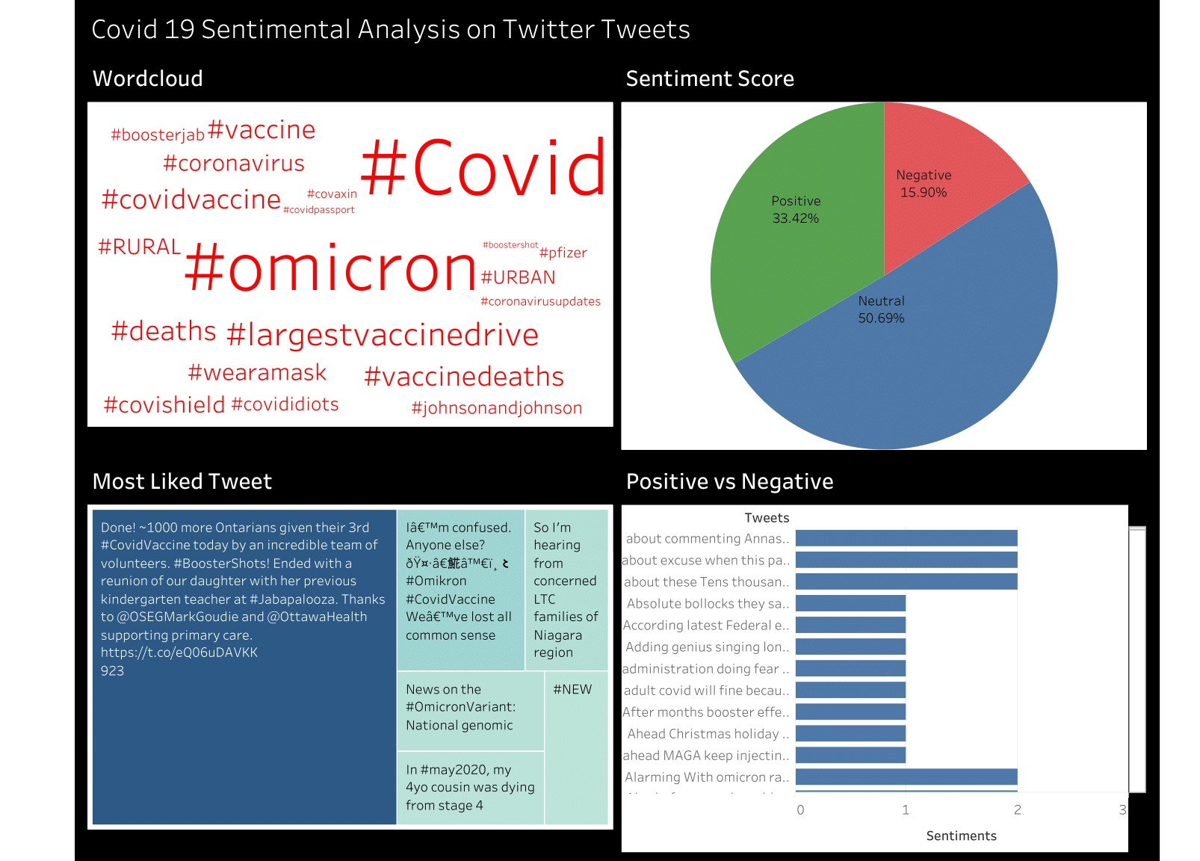
Visualization of the sentiments

Slide 10
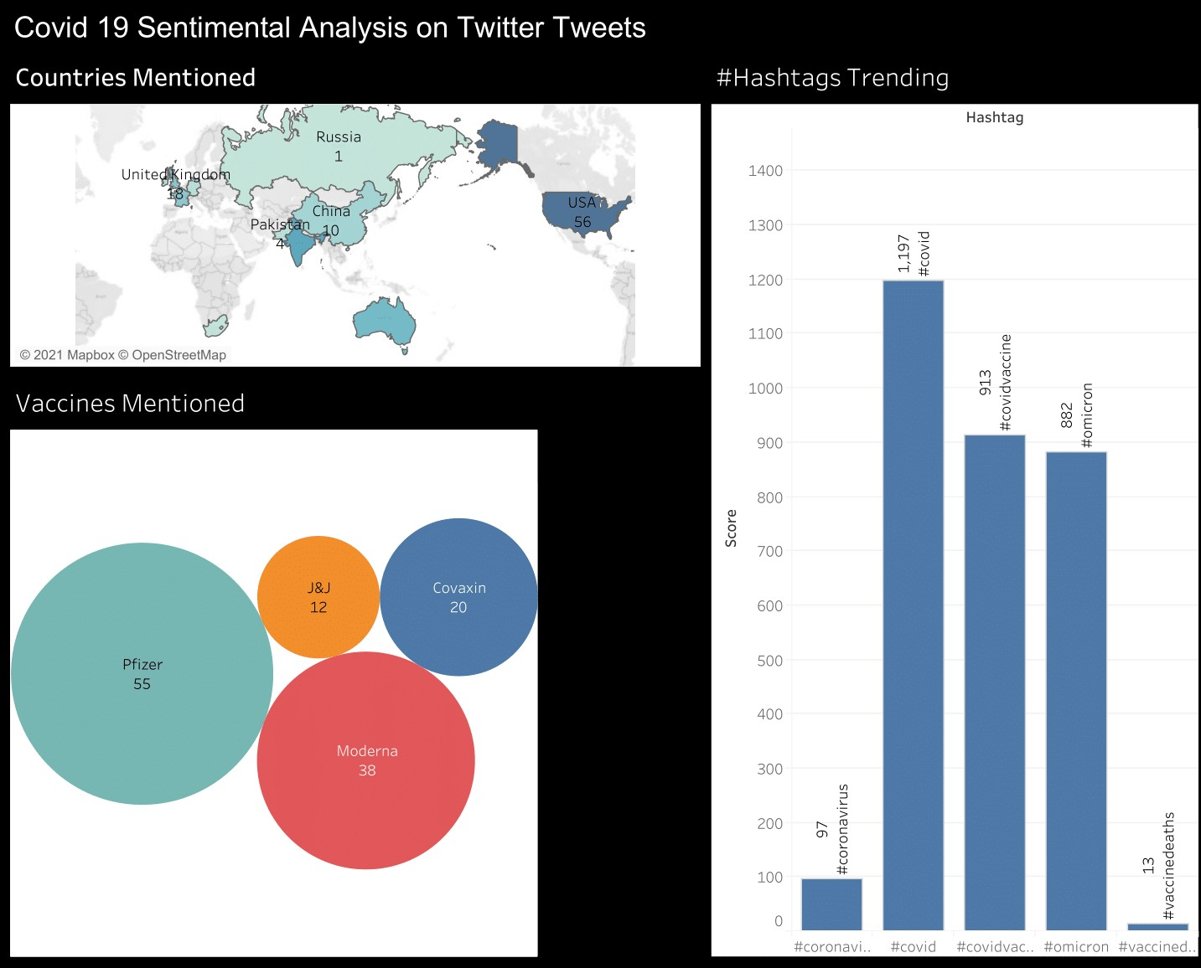
Visualization of the sentiments

Slide 11
THANK YOU
QUESTIONS?

